Slide 1
WHAT HAVE YOU BEEN UP TO??
Presentation activity!!

Slide 2
This week your activity is to share with me what you have been up to these past few weeks using a presentation format!
5-6 slides but you can add more if you want!

Slide 3
Let’s get to some slide ideas!

Slide 4
Have you been reading??

Slide 5
Maybe you have been playing videogames?

Slide 6
Have you played outside??

Slide 7
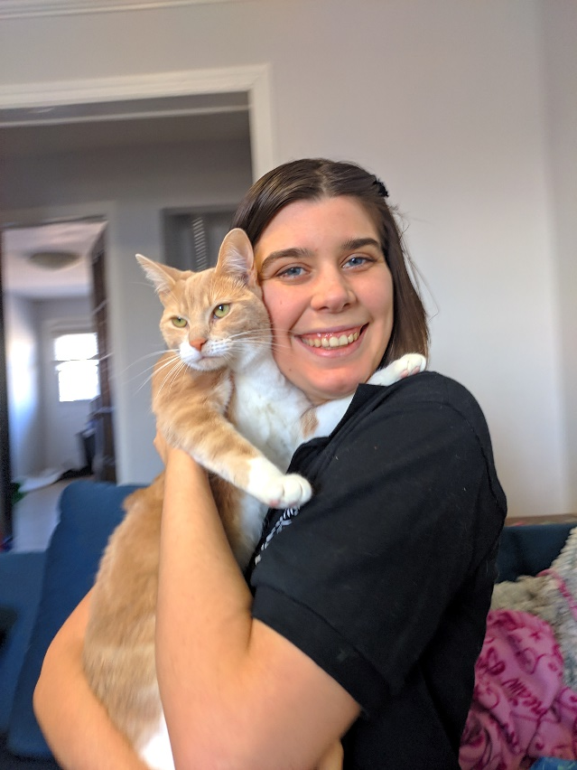
Have you played with your pets??

Slide 8
You can choose any activity that you want
These are just ideas!

Slide 9
Reminder on how to add new slides and pictures:
To add new slide, click on the tab Home and then New Slide
OR Insert and then New slide.
If want to change how the slide looks, click on layout.
To Insert pictures, go to the tab INSERT and then click pictures.
If the pictures you want are already saved, find them on your computer, click on the picture, and press insert.
If you want to use pictures from online, go to insert, then online picture, and search for the photo you want.
Once you find a picture you like, just click on the picture and insert.
Note** If you do not want to have pictures of yourself, you do not have to. Online pictures are fine.

Slide 10
But what if I don’t have PowerPoint??
If you do not have PowerPoint, Google Slides is available online and you can use your school account. If neither are possible, you can simply write to me what you have been up to and maybe add some pictures. No need for this to be super difficult.

Slide 11
Thank you very much!!
You can always send to kboyer@emsb.qc.ca

